Slide 1
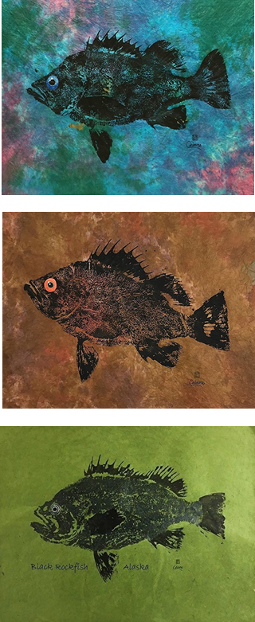
Accounting for population dynamics improves the use of no-take marine reserves for fishery management
Victoria Quennessen
MS Student in Fisheries Science
Hotel Coral y Marina, Ensenada, Mexico
Western Society of Naturalists
November 2nd, 2019

Slide 2
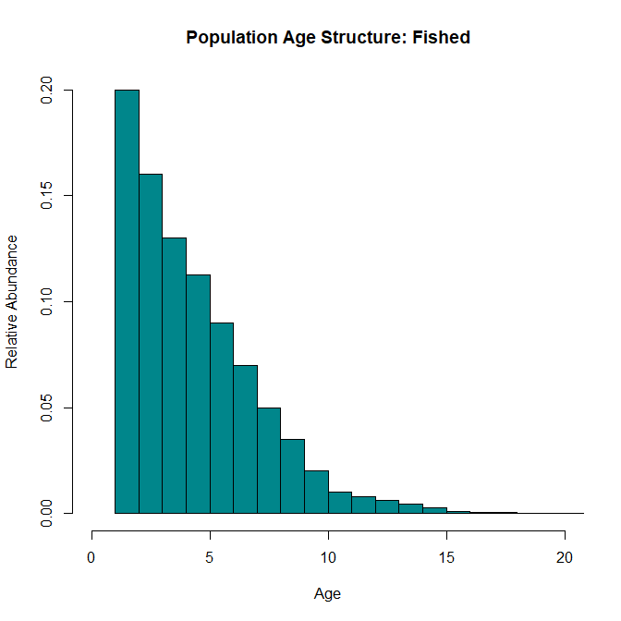
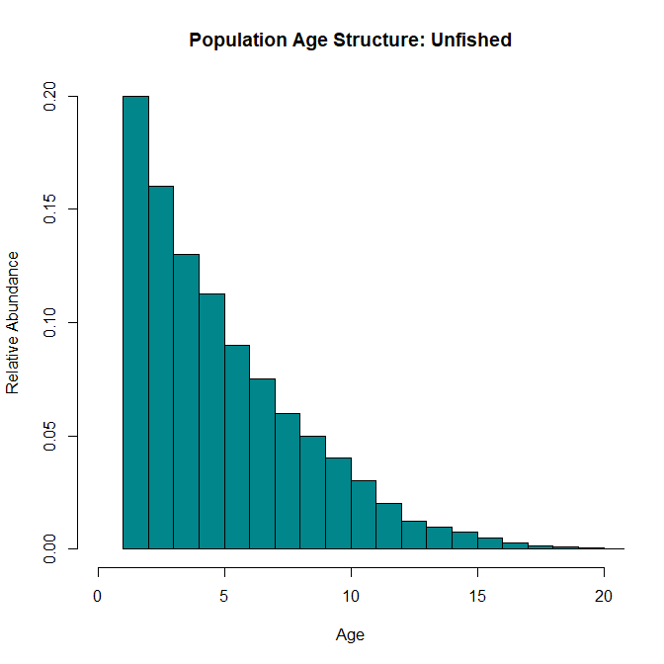
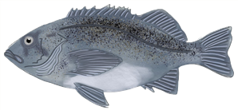
Effects of Fishing
Background
Methods
Results
Future Directions
Bigger, older individuals
Notes:
Effects of fishing:
Truncation of age structure
Decreased biomass and abundance
Increased vulnerability to fishing
Growing emphasis on use of marine protected areas (MPAs) to protect fisheries and reduce effects of fishing pressure
149 studies on 124 MPAs in 29 countries
As of 2015, 3.5% of world’s oceans in MPAs, about 1.6% strongly or fully protected (Lubchenco and Grorud-Colvert, 2015)

Slide 3
Effects of Fishing
Background
Methods
Results
Future Directions
Bigger, older individuals
Notes:
Effects of fishing:
Truncation of age structure
Decreased biomass and abundance
Increased vulnerability to fishing

Slide 4
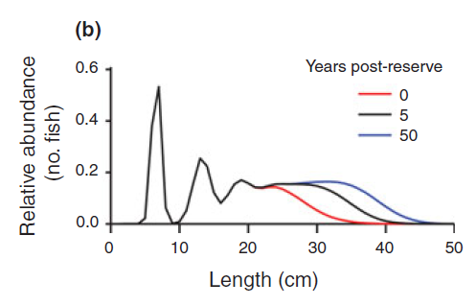
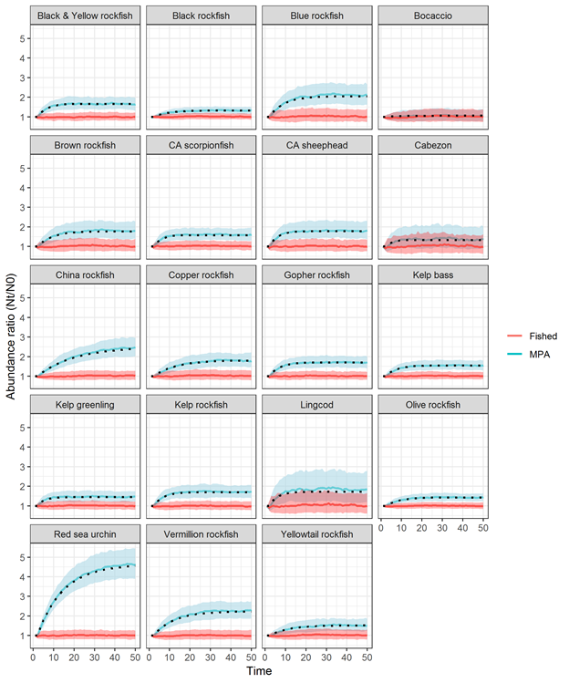
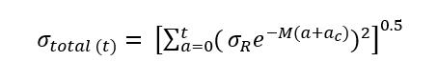
Background
Methods
Results
Future Directions
Transient Dynamics and Stochasticity
Abundance Ratio (N_{t}/N₀)
Fished
MPA
Time (years)
Adapted from Kaplan et al., in review
White et al., 2013
Notes:
Fix figure = too big
Standard deviation of population trajectory equation
Open population dynamics with stochastic recruitment
The rate at which the age structure fills in and biomass increases depends on the species’ natural mortality rate, von Bertalanffy growth rate, variability in recruitment, and the age at entry into the fishery (Kaplan et al. in review; White et al. 2013).

Slide 5
Background
Methods
Results
Future Directions
Objectives / research questions
Notes:
Fix figure = too big
Standard deviation of population trajectory equation
Open population dynamics with stochastic recruitment
The rate at which the age structure fills in and biomass increases depends on the species’ natural mortality rate, von Bertalanffy growth rate, variability in recruitment, and the age at entry into the fishery (Kaplan et al. in review; White et al. 2013).

Slide 6
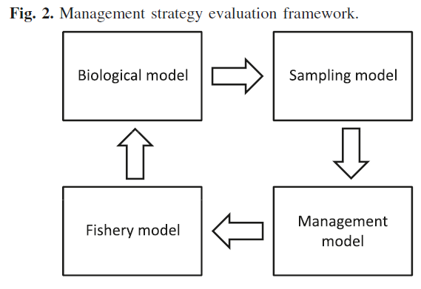
1. Replicate base model
Background
Methods
Results
Future Directions
Current west coast groundfish fishery has 40:10 control rule
Density ratio as metric to assess level of depletion:
# ind./ area outside reserve
-------------------------------------
# ind./ area inside reserve
Babcock & MacCall 2011
Notes:
Fishing effort is reduced for stocks below a certain threshold (B40%, or 40% of unfished biomass) until it hits B10%, after which the fishery is closed completely

Slide 7
2.
Background
Methods
Results
Future Directions
CR | 1 | 2 | 3 | 4 | 5 | 6 | 7 | 8
Type | DR | DR | DR | DR | DR | Effort | DR | Effort
Floor DR | 0.2 | 0.2 | 0.2 | 0.2 | 0.2 | NA | 0.2 | NA
Target DR | 0.6 | 0.6 | 0.6 | 0.6 | 0.8 | NA | 0.8 | NA
Effort Change Allowed | 0.1 | 0.1 | 0.1 | 0.1 | 0.1 | 0 | 0 | 0.1
Years Sampled | 3 | 1 | 1 | 1 | 1 | NA | 1 | NA
Fished Areas Sampled | All | All | Far | All | All | NA | All | NA
Fish Sampled | All | All | All | Mature | All | NA | All | NA
Control rules all use the DR, with a floor of 0.2, and an effort increase of 0.1 allowed
Target DR at 0.6 or 0.8
Samples for 1 or 3 years
Samples all areas, or far areas
Samples all fish, or mature fish
Notes:
Fishing effort is reduced for stocks below a certain threshold (B40%, or 40% of unfished biomass) until it hits B10%, after which the fishery is closed completely

Slide 8
Variance vs. sample size
Background
Methods
Results
Future Directions
P
Notes:
Define M and k

Slide 9
Transient dynamics
Background
Methods
Results
Future Directions
P
Notes:
Define M and k

Slide 10

Next steps:
Background
Methods
Results
Future Directions
Partner with ODFW
Compare results to real data
Potentially help ODFW prep for 2023 OR marine reserve assessment
Notes:
Define M and k

Slide 11
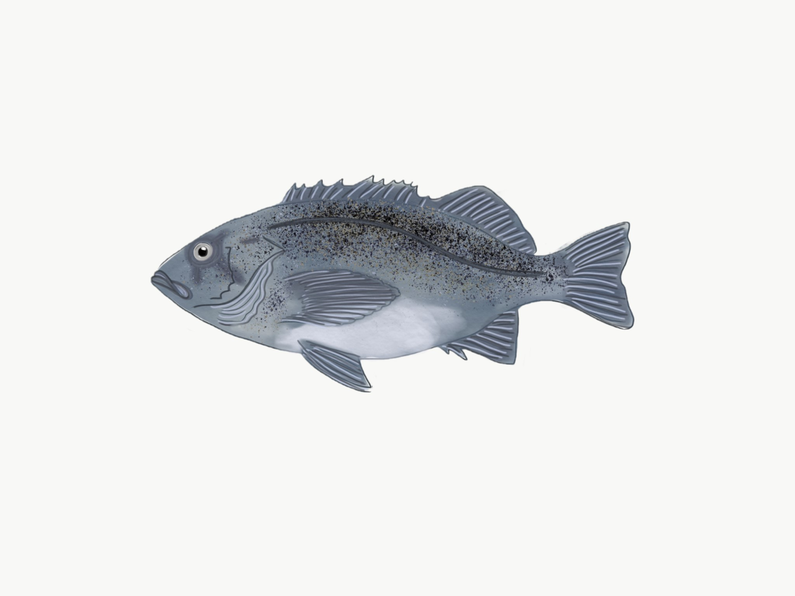
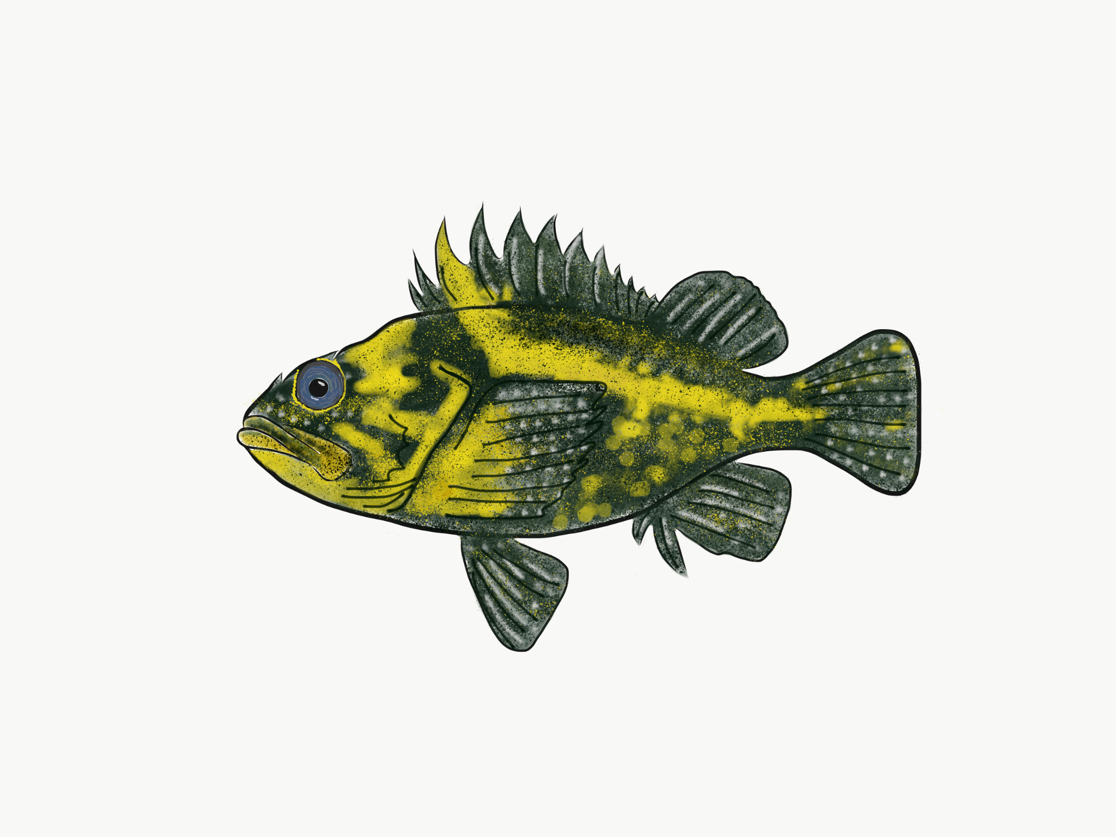
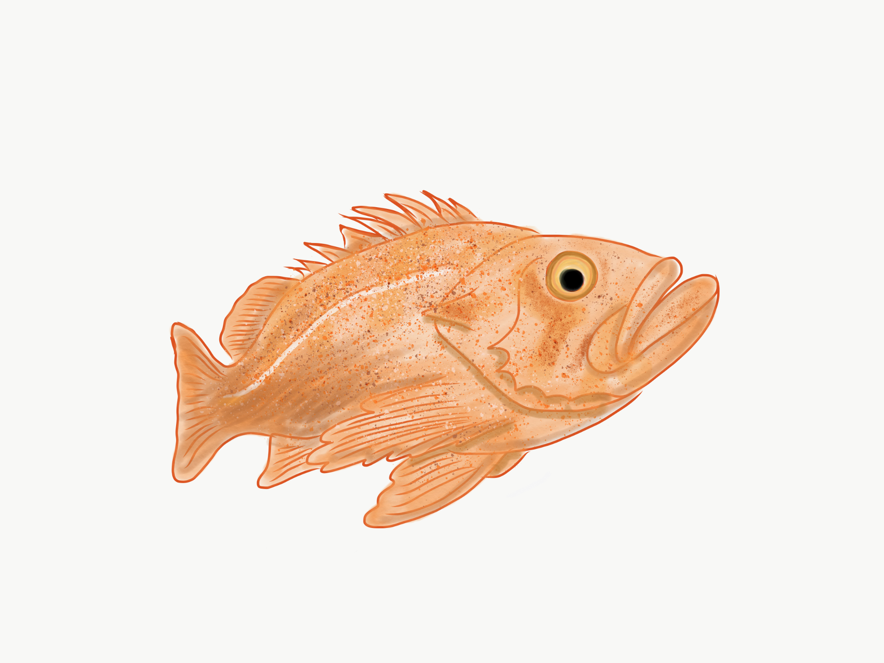
Background
Methods
Results
Future Directions
Replicate base model
Incorporate variability and stochastic recruitment
Explore timescales
Compare control rules
Alex Avila
Alex Avila
Alex Avila

Slide 12
Outcomes
Background
Key Questions
Methods
Hypotheses
Outcomes
Improved methodologies for assessment and management of fisheries populations in marine reserves following implementation
Open-access R model
Alex Avila
Alex Avila
Alex Avila

Slide 13
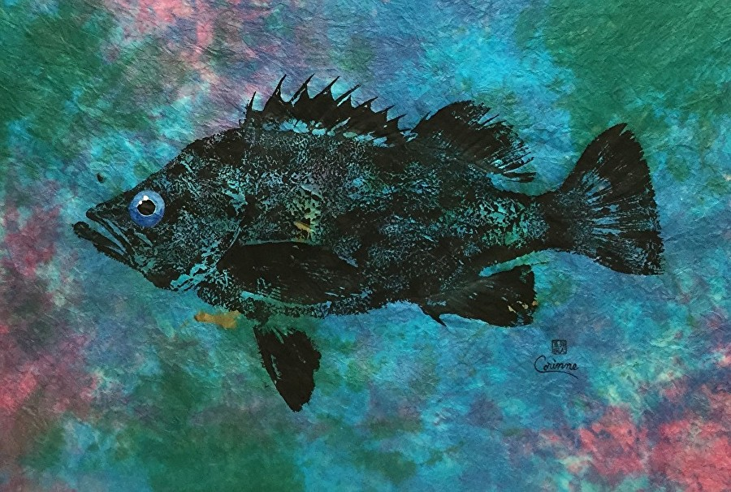
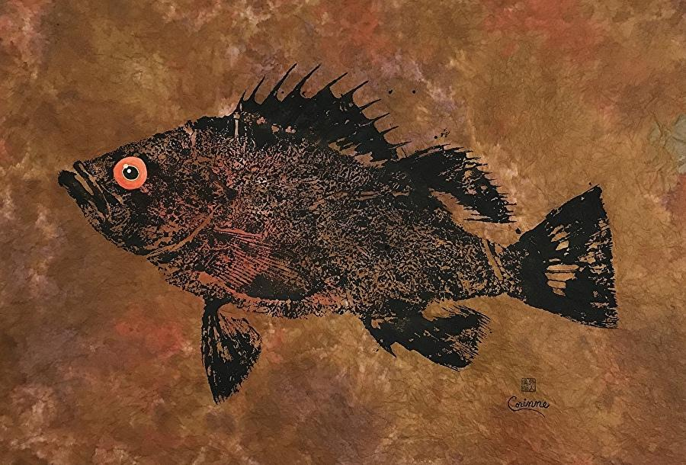
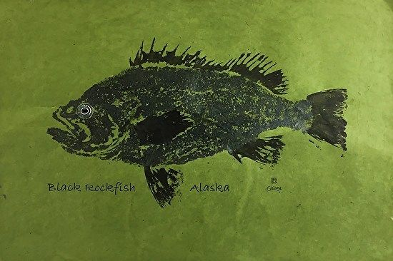
Key Questions
Background
Key Questions
Methods
Hypotheses
Outcomes
How can we best use information from within reserves to help manage fisheries following reserve implementation?
What are the timescales?
How can we apply control rules?
How do different life history characteristics affect timescales?
Notes:
shorten

Slide 14
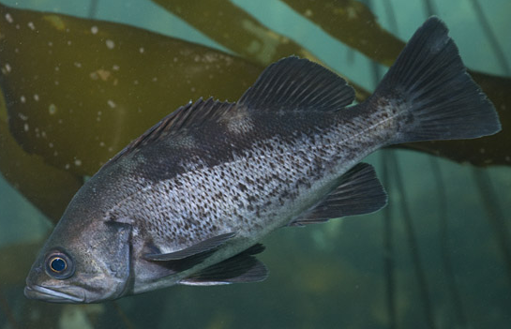
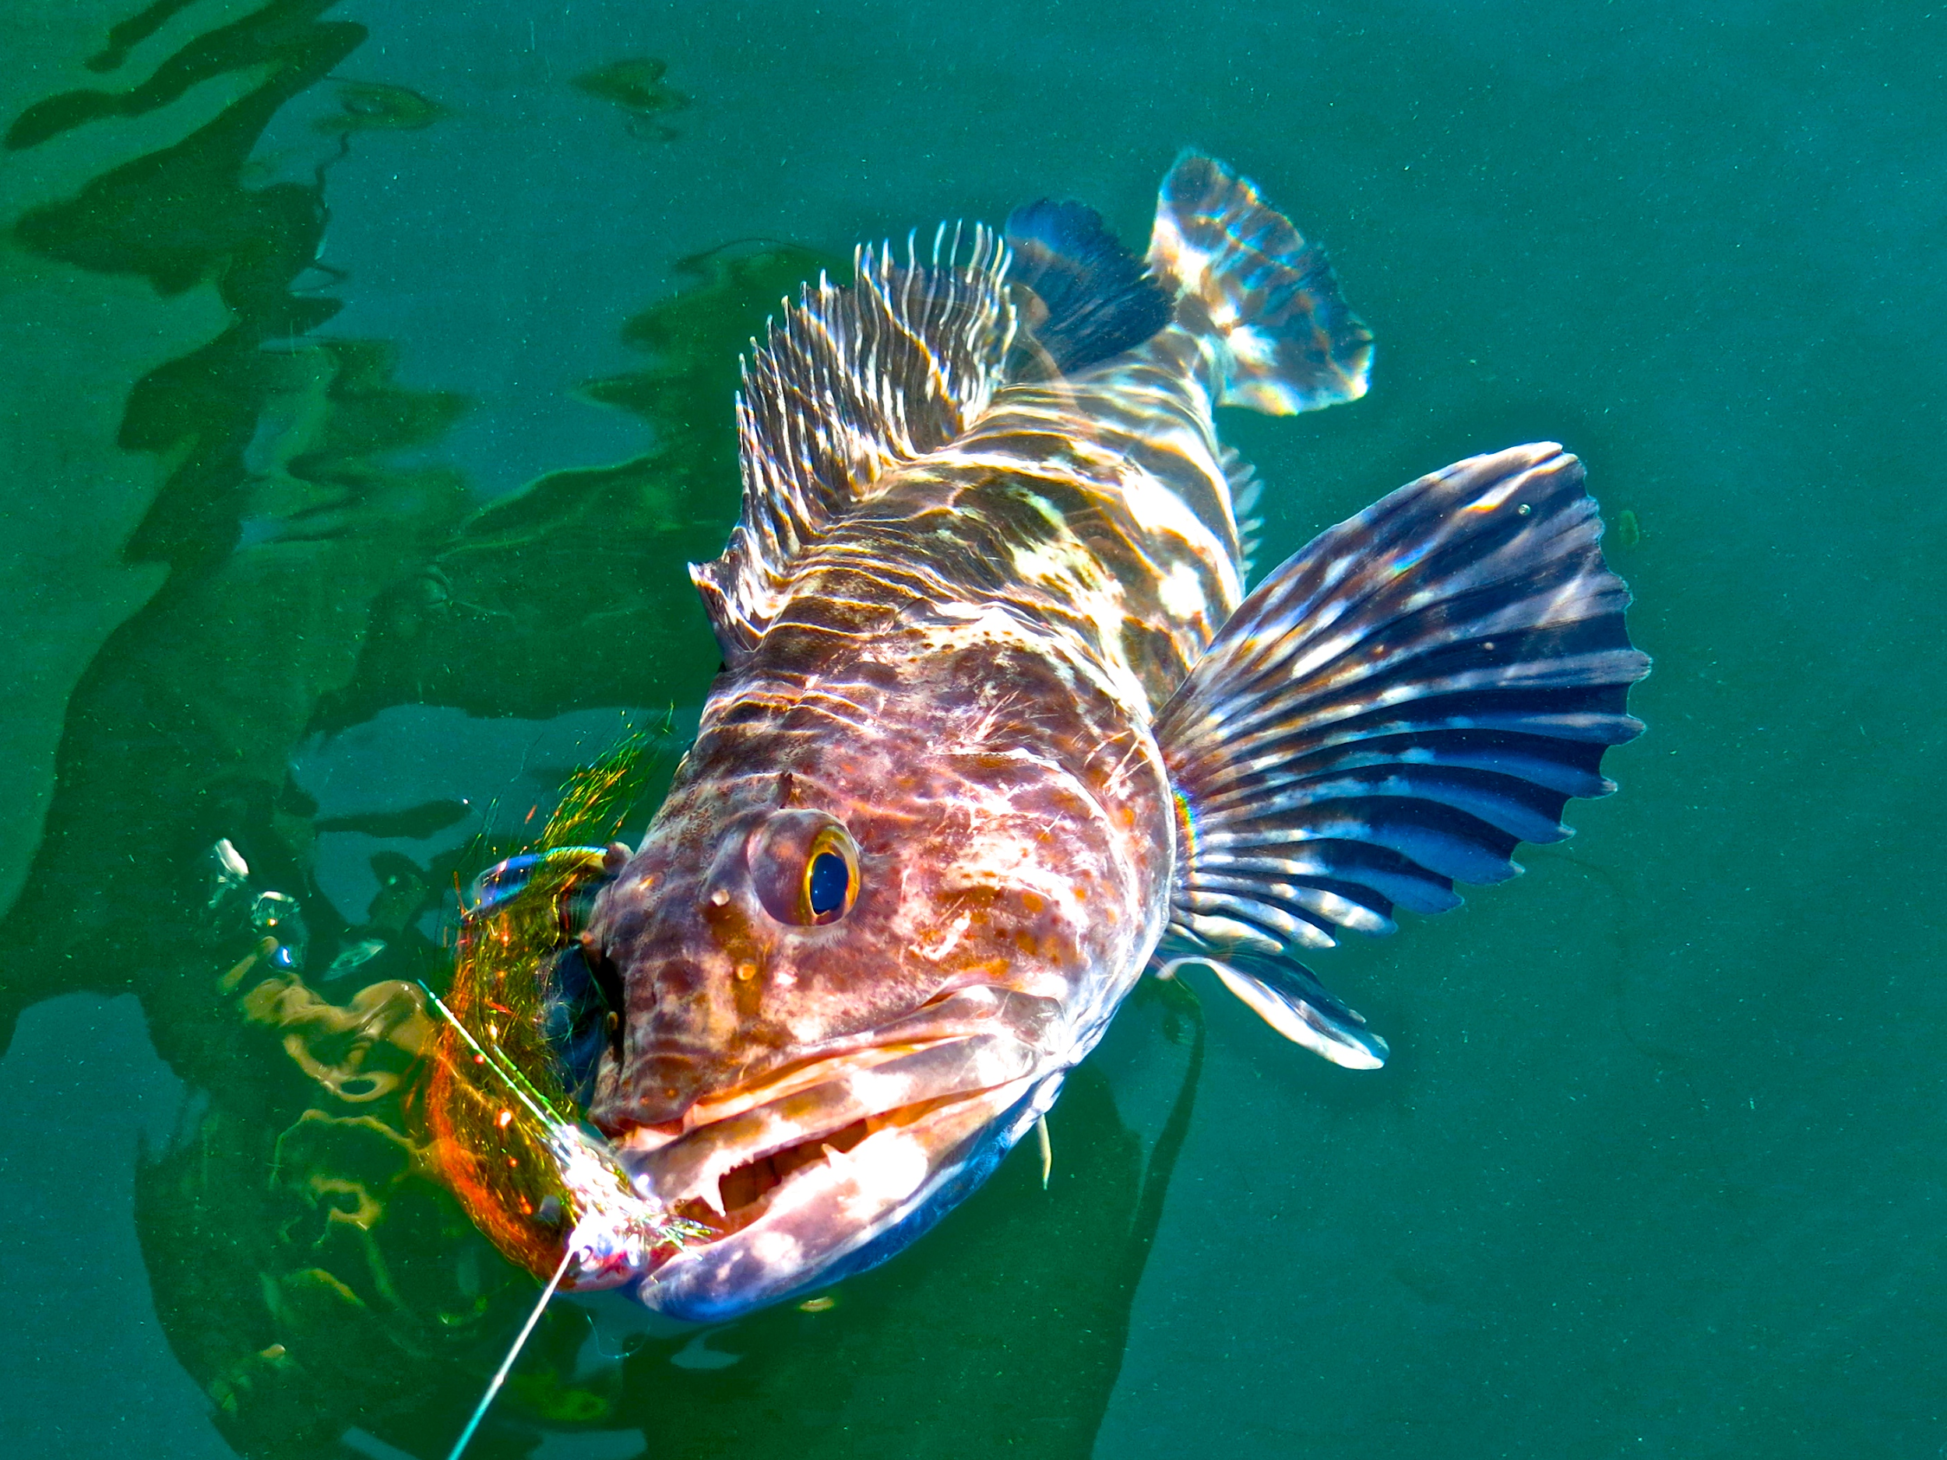
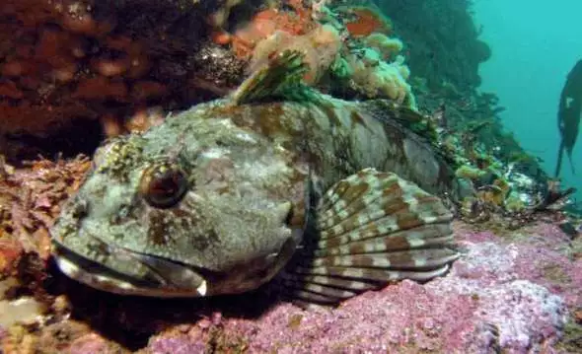
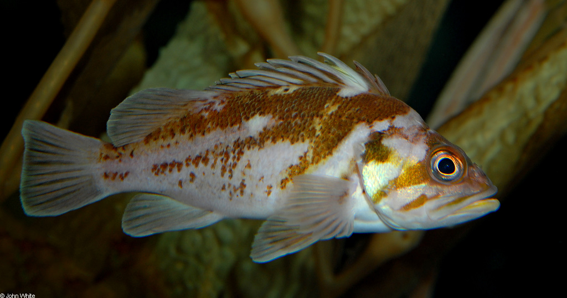
Study species: Black rockfish (Sebastes melanops)
Background
Key Questions
Methods
Hypotheses
Outcomes
Black rockfish (Sebastes melanops)
Lingcod (Ophiodon elongatus)
Cabezon (Scorpaenicthys marmoratus)
Copper rockfish (Sebastes caurinus)
Levi
Jay Nichols
FishWithJD
John White
Notes:
Fix citations (see title slide)
All are commercially or recreationally important off the coast of Oregon
Rockfish fishery (mainly recreational) nets state $14 annually, mostly due to black rockfish, increasing since 2015

Slide 15
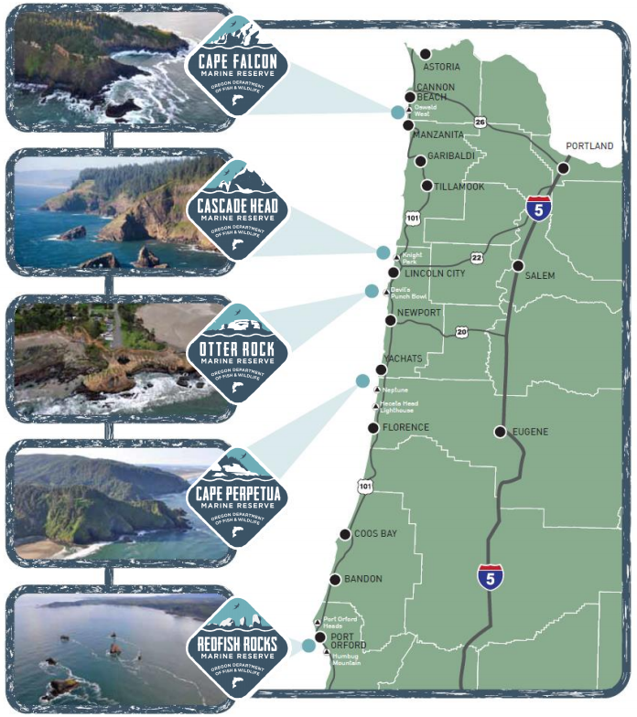
Oregon Marine Reserves
Background
Key Questions
Methods
Hypotheses
Outcomes
ODFW has implemented 5 marine reserves off the coast of OR in last 10 years
Need some way to assess reserves
Promote biodiversity (ergo population persistence)
Minimize costs to communities

Slide 16
Hypotheses
Background
Key Questions
Methods
Hypotheses
Outcomes
Different species with different natural mortalities and growth rates will show different timescales after reserve implementation
Lower natural mortality (M) + higher growth rates (k) = shorter timescales
Incorporation of transient dynamics and stochastic recruitment will lead to improved adaptive management
Lowest M
Highest k
Notes:
shorten

